Slide 1
CROWD SIZE ESTIMATION
EE722 Course Project –
Arihant Barjatya – 180102012
Sankeerth Reddy - 180108034

Slide 2
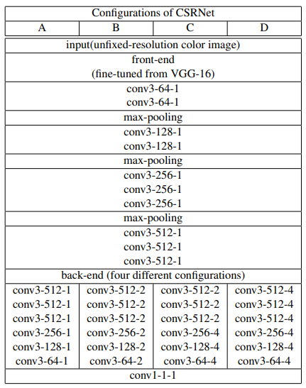
Architecture – CSRNet with VGG frontend
The model architecture is divide into two parts, front-end and back-end. The front-end consists of 13 pretrained layers of the vgg16 model. The fully connected layers of the vgg16 are not taken.
The back-end comprises of dilated convolution layers. The dilation rate at which maximum accuracy was obtained was experimentally found out be 2 as suggested in the CSRNet paper.

Slide 3
Dataset
This dataset consists of two parts as Part A containing 482 images with highly congested scenes randomly downloaded from the Internet while Part B includes 716 images with relatively sparse crowd scenes taken from streets in Shanghai.
The ShaghaiTech dataset provides us with head annotations, this sparse matrix was converted in a 2D density map by using a Gaussian Filter. Then we sum all the values in the density map to get the actual count.

Slide 4
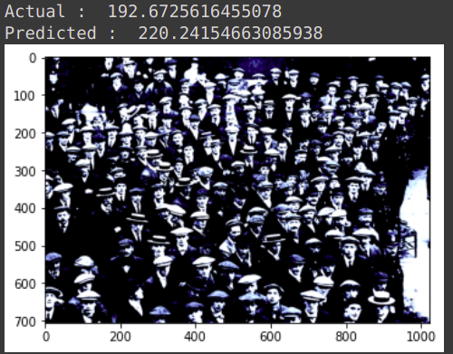
Results – ShanghaiTech Dataset A
Mean Absolute Error(MAE) was around - 88.232

Slide 5
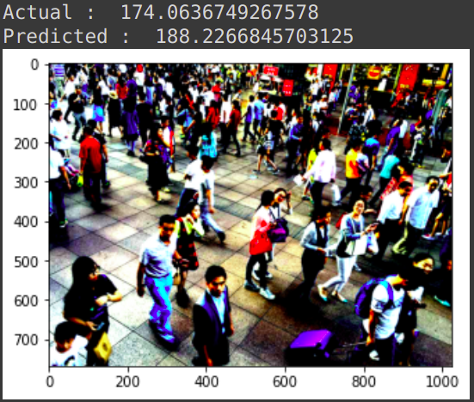
Results – ShanghaiTech Dataset B
Mean Estimate Error(MAE) was around – 16.684

Slide 6
Conclusion -
CSRNet works best for sparse images(Part B dataset) and slightly worse for highly congested scenes(Part A dataset).
CSRNet uses dilated convolutions which increase its receptive filed without losing resolution.
CSRNet generates Density map so we can estimate crowd in a given patch of an image.

Slide 7
THANK YOU

